Slide 1

404 error
Bugs not found

Slide 2

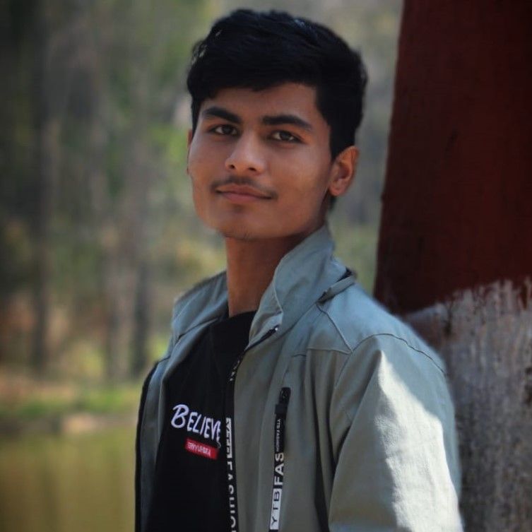

Team members
Anurag Dahal (blaze)
Tilak Thapa (jrTilak)
Utsab Pandey (kaleUtsab)
[Quality Tester/Assistant]
[Coder/Designer]
[Data Miner /Designer]

Slide 3
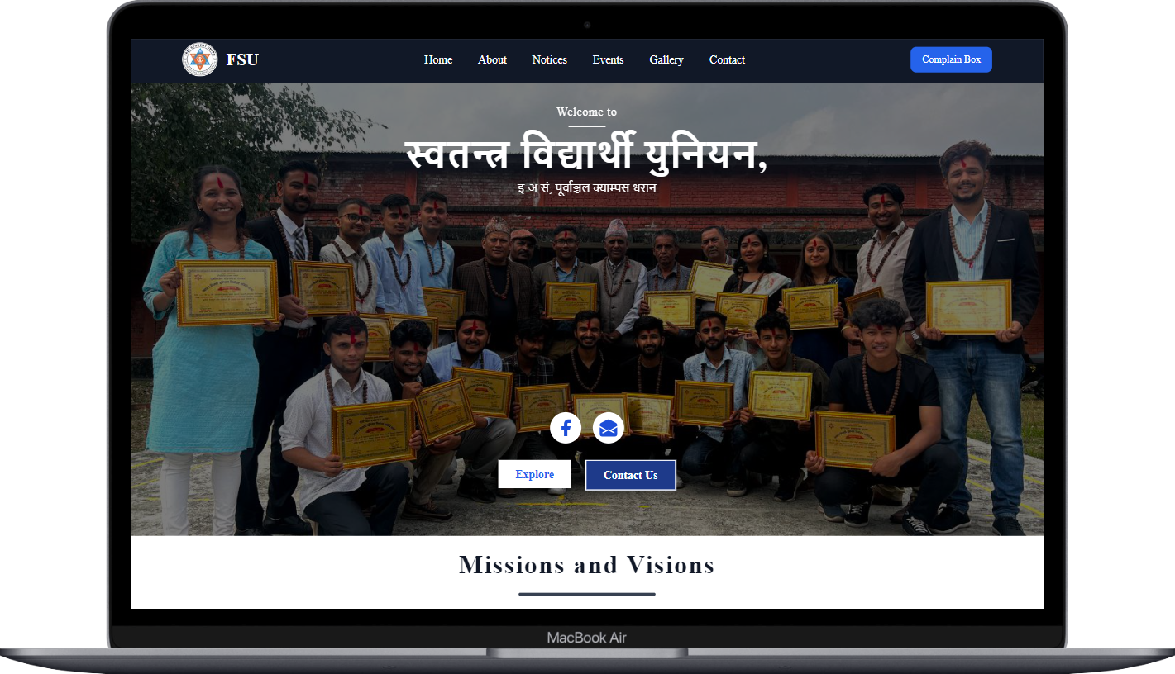
WEL-COME TO WEBSITE DEMONSTRATION OF FREE STUDENT UNION

Slide 4

Modern Websites (must have):
Functionality
Performance
Search Engine Optimization (SEO)
Simple and Straight forward UI (Responsive
Design)

Slide 5

Functionality of our website
Interaction with FSU community.
Provide details About FSU members and its works.
Shows recent notices/news.
Information about upcoming events.

Slide 6
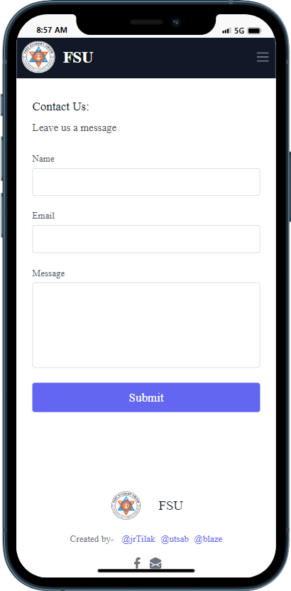
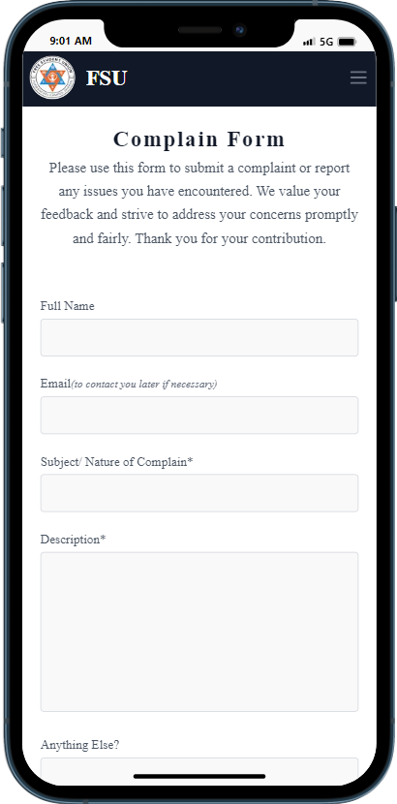
Interaction with fsu
Able to send message through contact from.
Able to send complains, feedback through complain from.

Slide 7
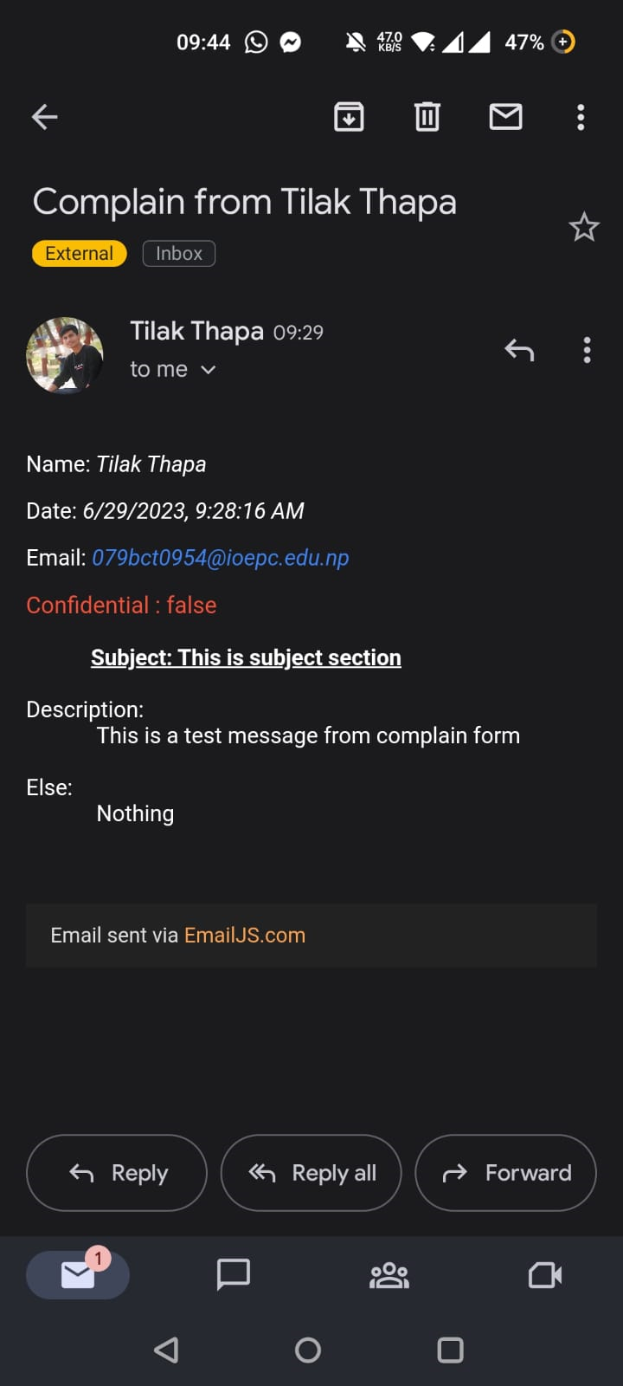
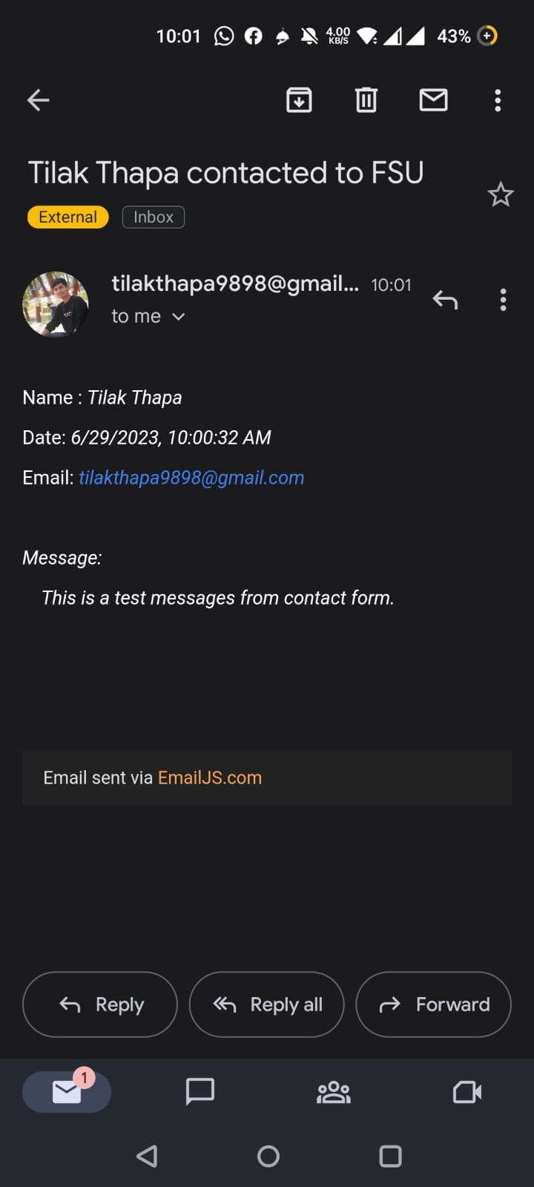
Preview

Slide 8
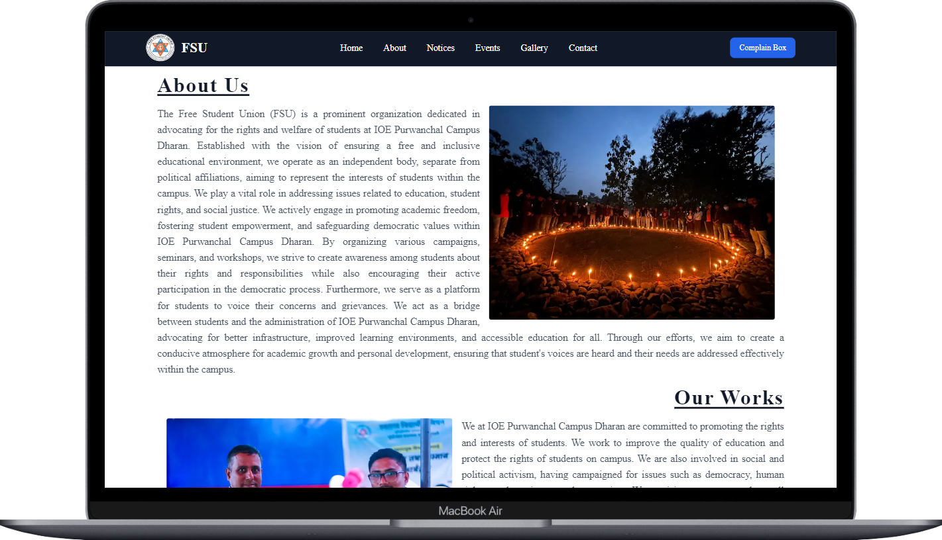
About page

Slide 9
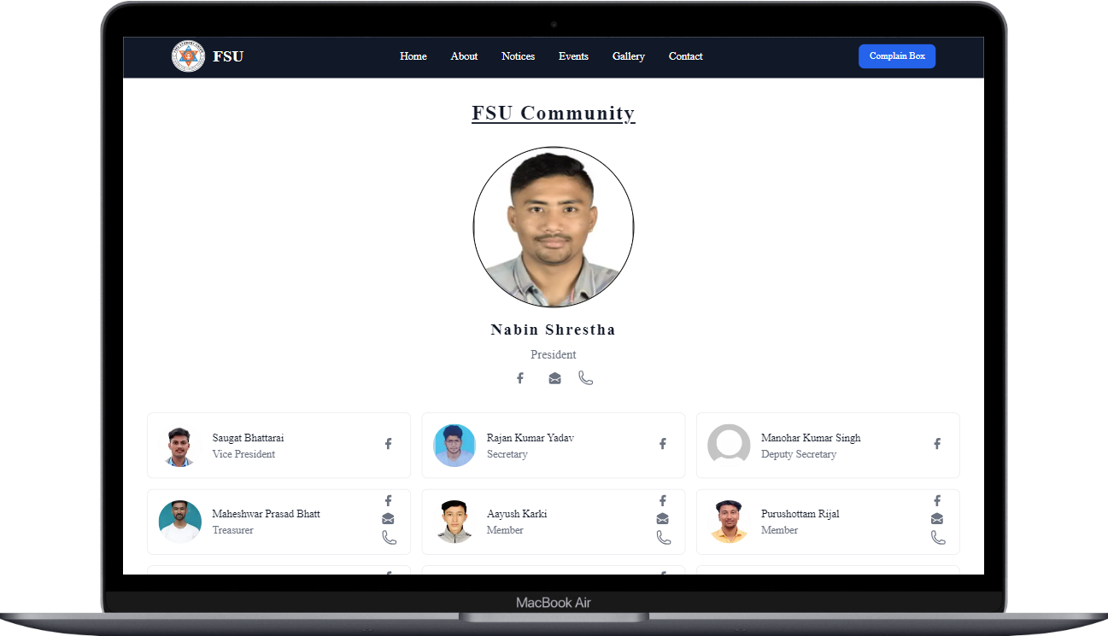
Members details

Slide 10
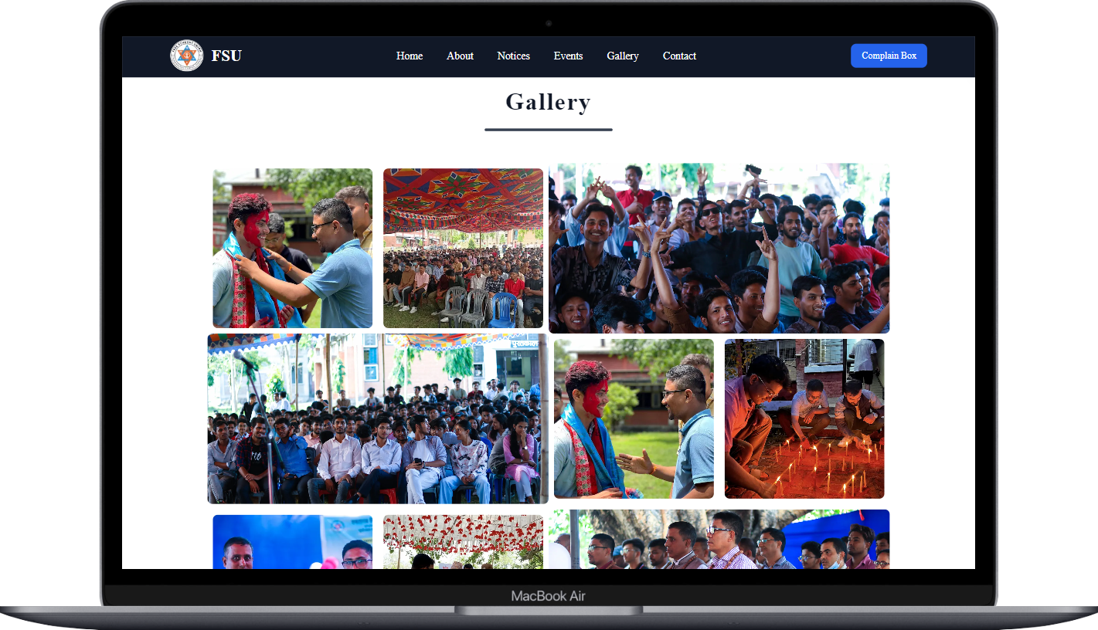
Gallery

Slide 11
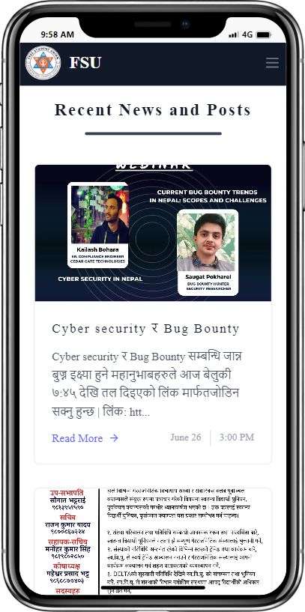
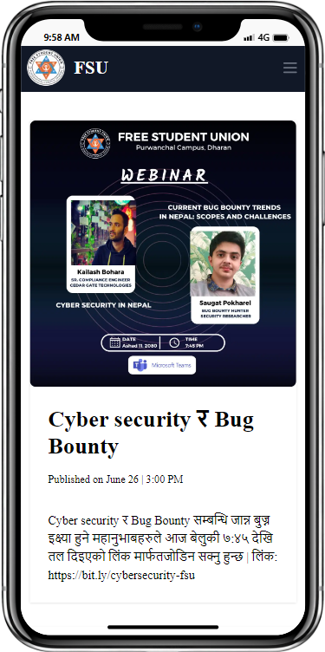
Show recent notices

Slide 12
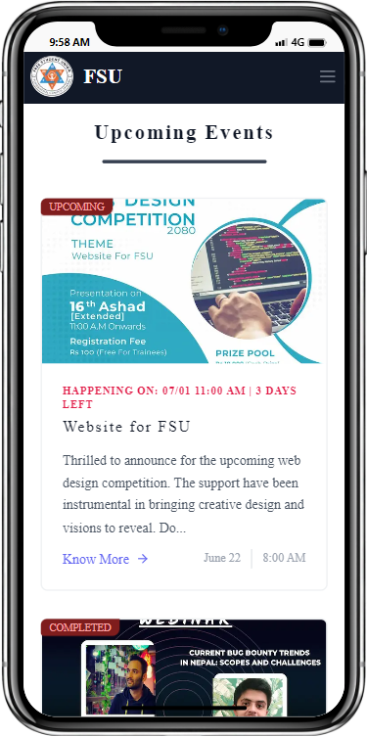
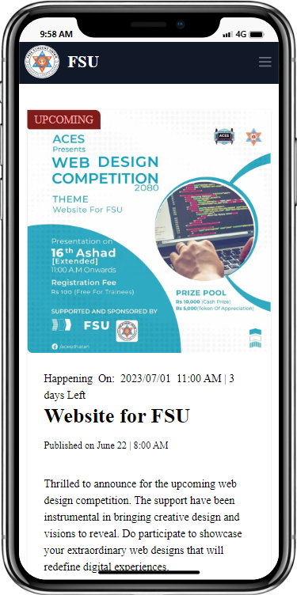
Info about events

Slide 13
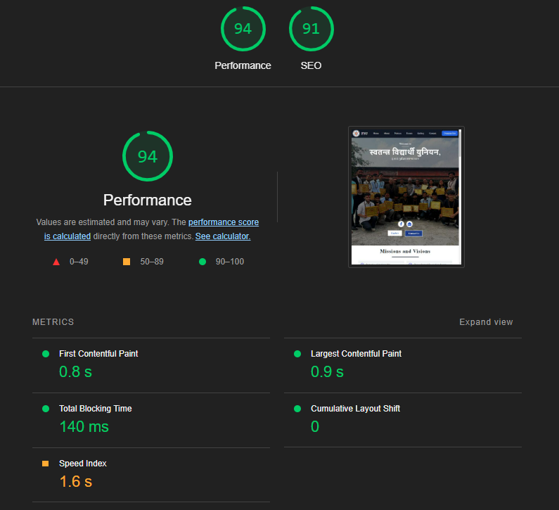
performance
Performance is the crucial part of a website.
Lighthouse report on performance .

Slide 14
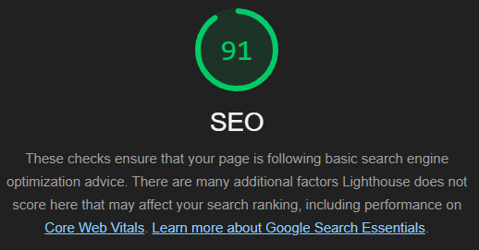
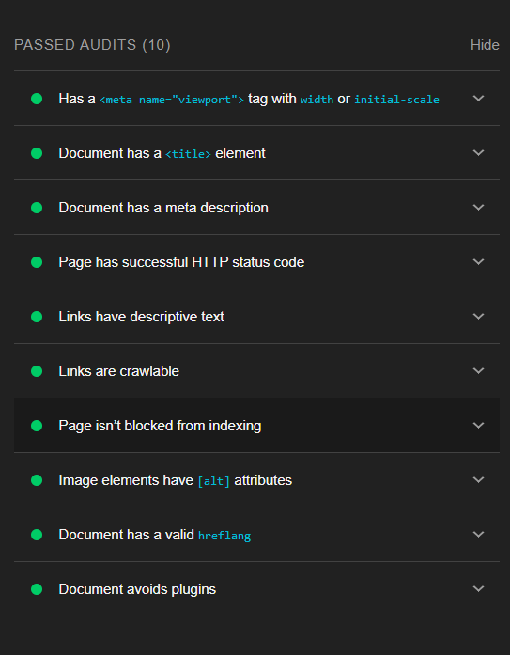
Search engine optimization
Seo is the crucial part of modern websites.

Slide 15
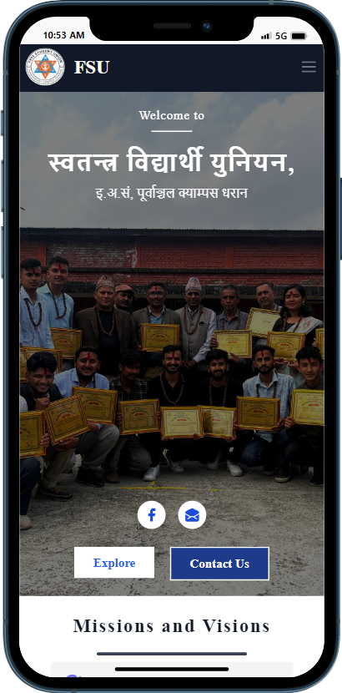
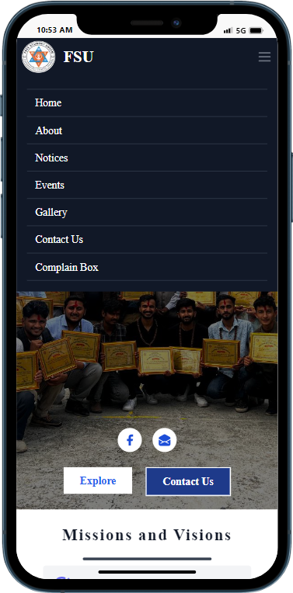
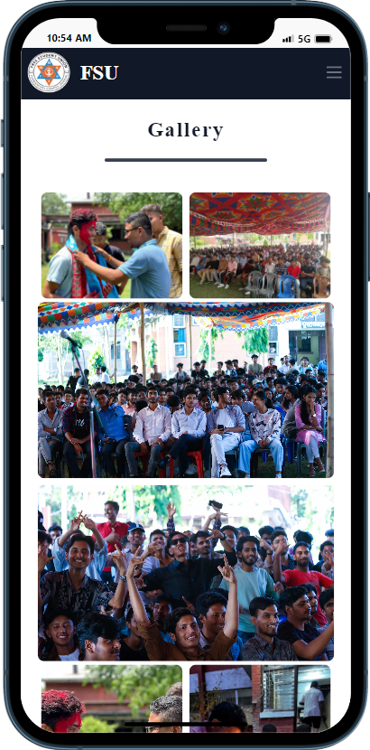
Responsive design

Slide 16
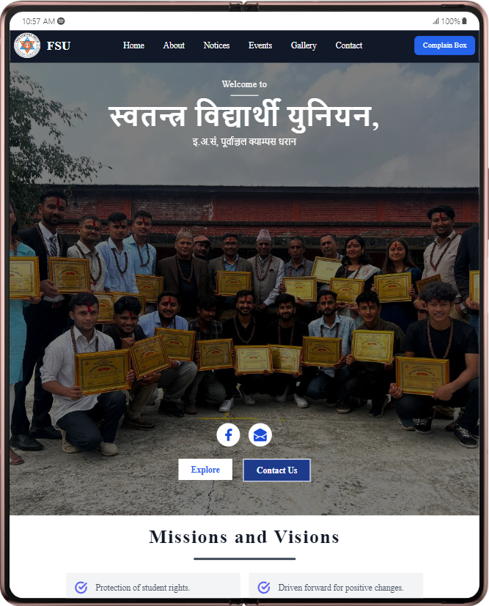
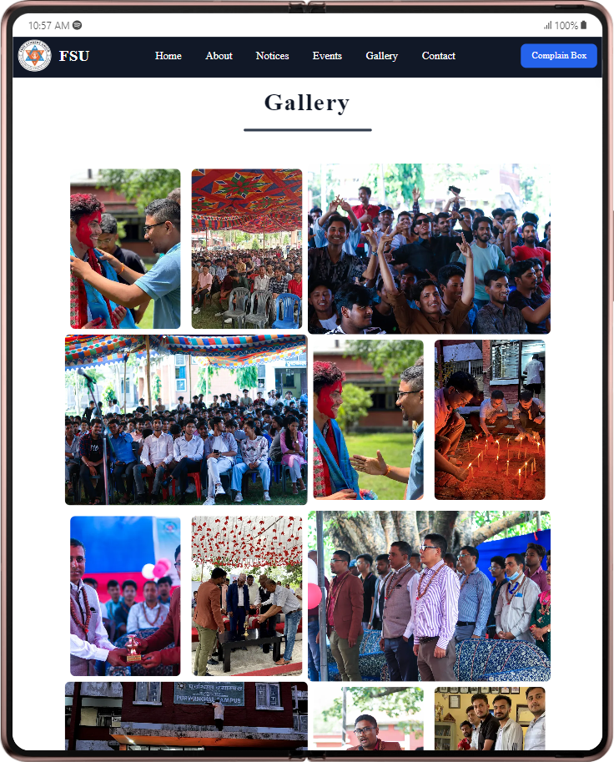
Responsive design

Slide 17
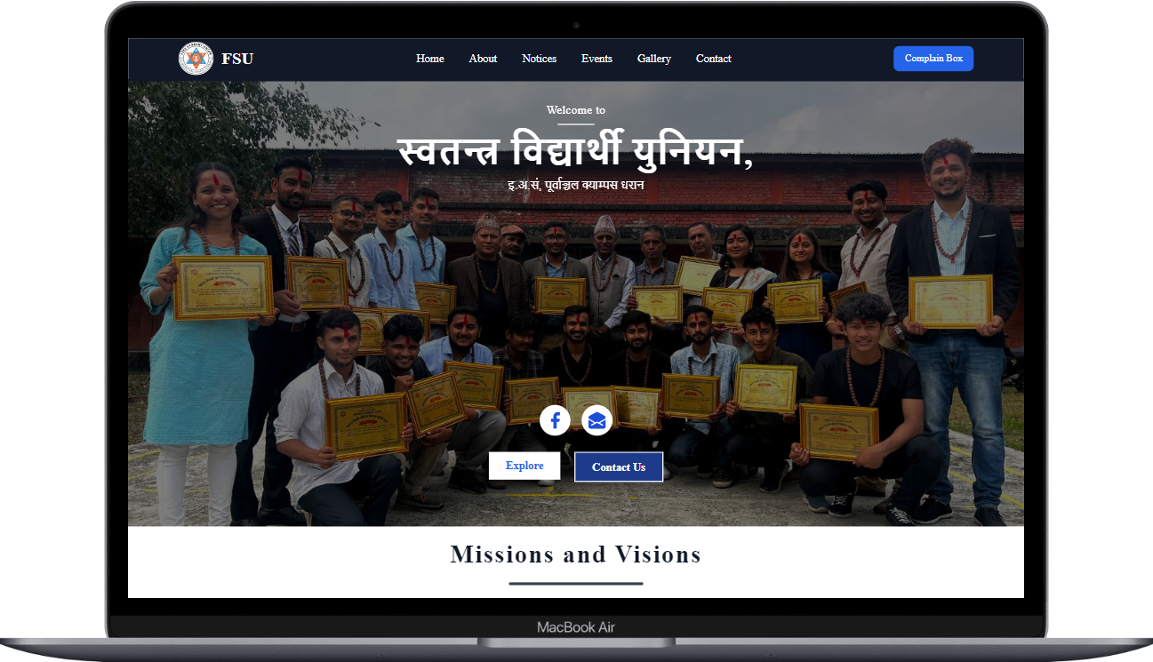
Responsive design

Slide 18




Technologies used:
Next.js / React.js – web frameworks
Tailwind CSS – styling website
Emailjs – sending and receiving emails / messages

Slide 19
Live website demonstration

Slide 20
conclusion
We explored the principles of modern website design, the technologies used in its development, and the importance of responsive design for optimal user experience across devices. We discussed the website's functionality, interactivity, and its commitment to search engine optimization (SEO) for improved visibility and organic traffic. The presentation emphasized the website's performance, showcasing its loading speed, - techniques, and the positive impact on user engagement. Additionally, we covered the user experience and navigation, emphasizing the user-centered design approach, intuitive navigation, and responsive design. Overall, our website aims to serve the needs of students, enhancing their experience on campus through informative content, user-friendly navigation, and engaging features. We are committed to ongoing improvements and look forward to delivering a valuable online platform for the student community.

Slide 21
Conclusion
Used frameworks like tailwind css and bootstrap for template design
Included the modern technologies like
Next js
React
Email js
Achieved Search enigne optimization(SEO)of 91% and 94 % performance as per …….
Responsive
All the necessary datas and informations about FSU and its activities can be found

Slide 22
THANK YOU

